Slide 1
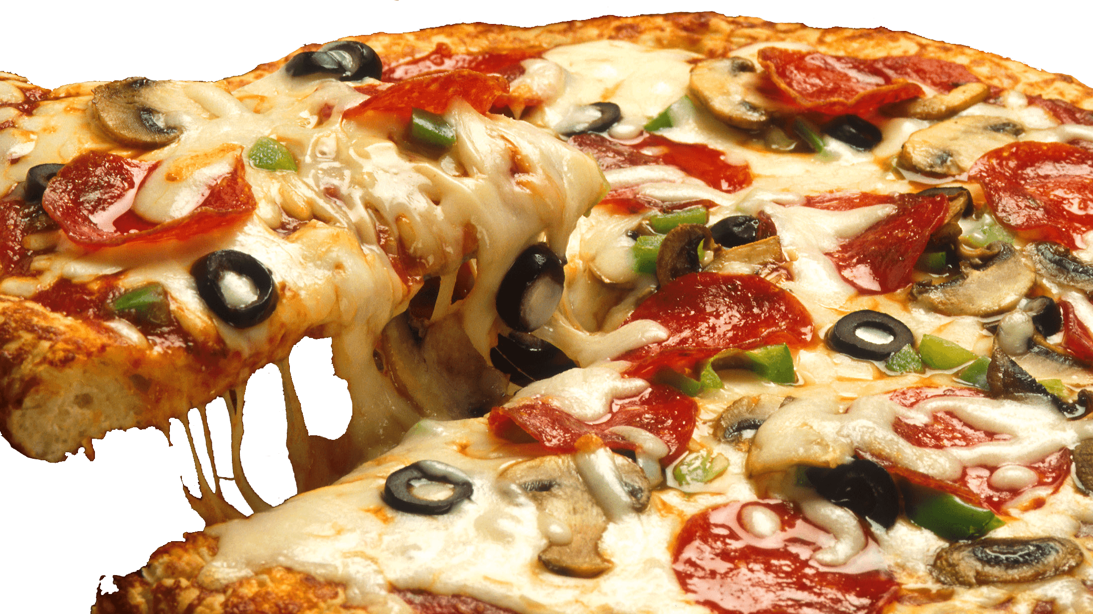
Trimino
By Emmy Ea and Jonathan Dimitriu

Slide 2
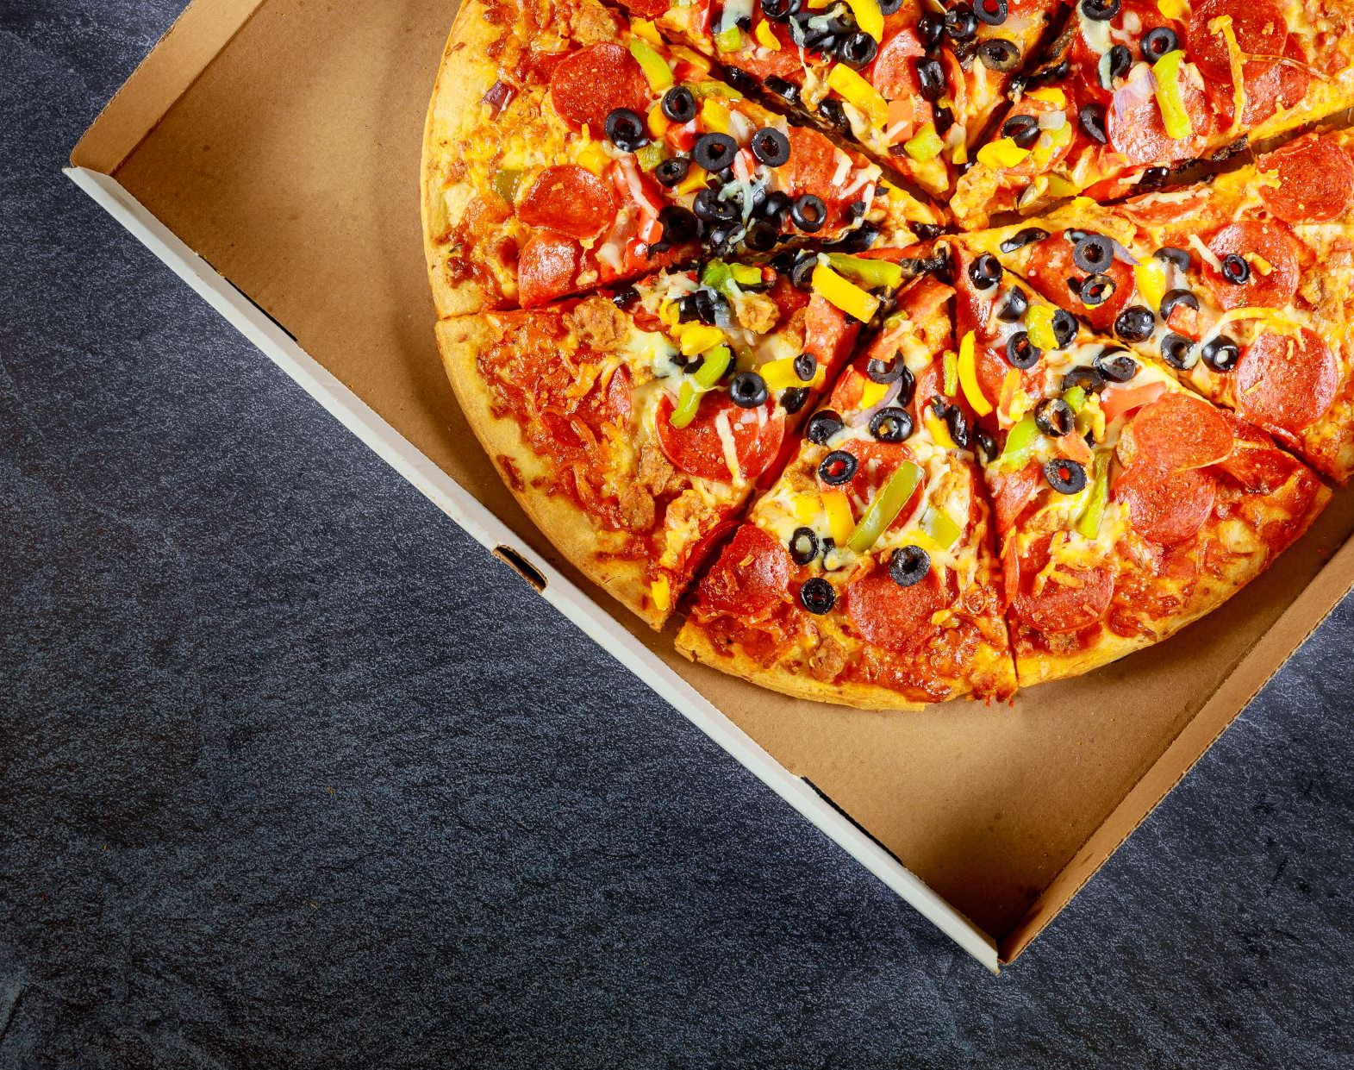
How did you determine which features to include in your app?
We wanted to make an app that would englobe what we learned in class.
Our application is centered around an online pizza store.
Thus, the features we choose pertained to a shopper's experience in an online app to order pizzas.
Our features facilitates the user’s navigation to order, checkout, locate and contact our store.

Slide 3

Excluded features?
Admin feature was excluded because pizzas could not be added manually into a recycler view due to sizes and toppings.
Complications with subcategories.

Slide 4

How did you choose which technologies to use?
Firebase, because it was easier to navigate the authentication and real time database.

Slide 5

How did you divide the work among your team? You must tell us who worked on which parts!
Emmy
UIs(frontend)
Authentication(login)
Register
Background Music
Add pizzas to firebase
Delete pizzas from firebase
View pizzas from firebase
FAB for media sites
View coupons
Location search
Jonathan
Contact Us
Slider
Coupon Code
Progress Bar
Menu

Slide 6

What were some major difficulties that you have to overcome?
Authentication/login/register, we weren’t aware that to authenticate to firebase. User’s password needed to be 6 characters long.
Order pizza and saving it to Firebase
RecyclerView to display pizzas from Firebase
Delete from the RecyclerView pizzas and Firebase
Get total of all pizzas from Firebase
Music was restarting every activity

Slide 7
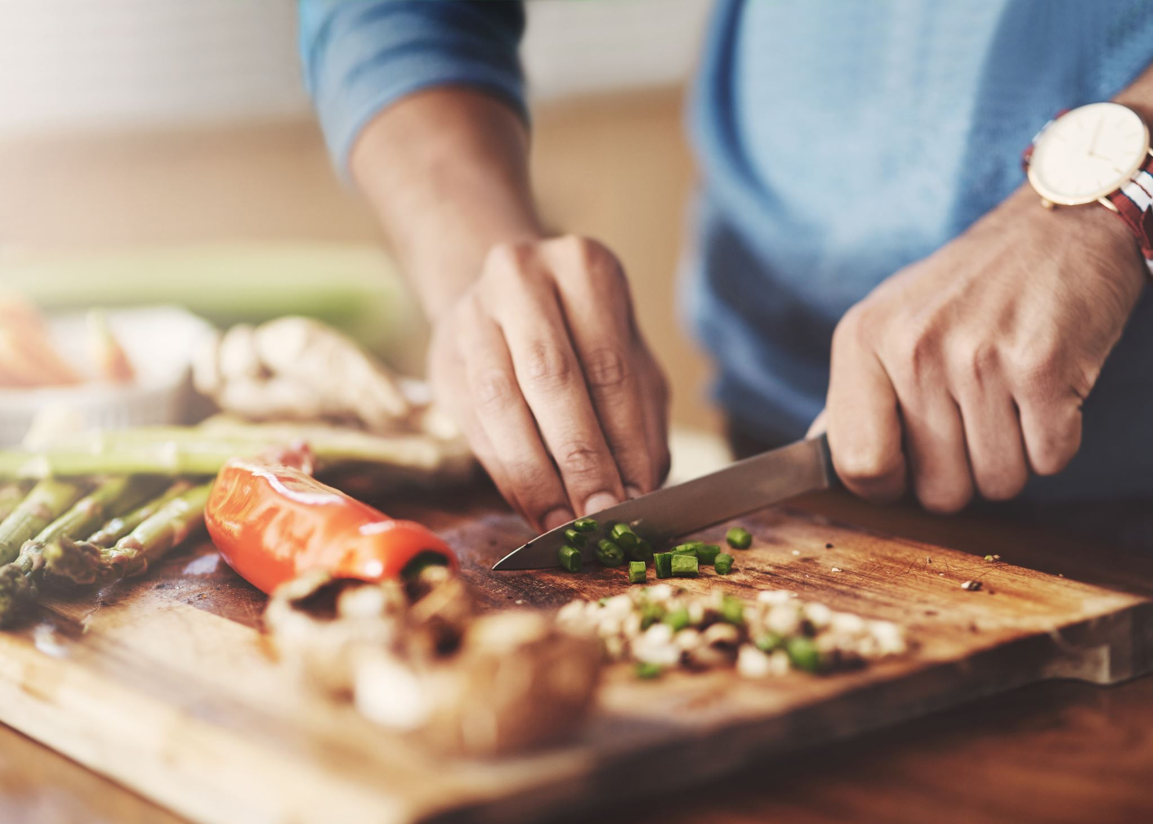
What went easier than expected?
Location
Social Media Links
RecyclerView for coupons

Slide 8
How can you improve your app in the future?
Tracking for delivery
Images of pizzas in cart

Slide 9

How did you deal with git conflicts?
Saved backup in case
Deleted folder
Branches created of our attempts and proceed to troubleshoot the created branch.

